Slide 1
Systems & Lasting Change
Tools | ANALYSIS |accountability | Communication

Slide 2
About Us
Tresa Adair – VP Systems & Marketing
Systems Implementation over past seven years
Custom solutions
Off-the-shelf modular systems
Communication planning & implementation
Environmental, Safety and Engineering consulting firm

Slide 3
Next 30 minutes to include:
Five (5) year Case Study
Suggestions on Strategy
Communication and accountability and why it’s critical
Live Demo of typical EHS Management System

Slide 4
CASE STUDY - Background
7
2,500
PROTEIN
Food Industry
Manufacturing Sites
Employees
Protein Powders, Supplements, Nutritional Bars
Includes office & manufacturing
Illinois, Florida, SC, United Kingdom
MANUFACTURING

Slide 5
The Challenge
High Injury Rates
Budget
Management Support
Tools
Communication
Policies deficient and injuries increasing
One EHS Professional, limited budget for future assistance
On surface committed, but, limited when funds are requested and time for training
Excel based tracking or none at all
Limited visibility to challenges

Slide 6
Solution
STRATEGY FIRST
Tools are useless without a well planned strategy
Prioritize
Authorize
Monetize
Identify High Priority Items, then map out short term and long-term plan
Gain Management Support
Tie tools needed for change to benefit to company

Slide 7
Priorities
Year One
Year Two & Three
Decrease Claims
Accountability & Real Culture Change
Continuous Evaluation
Year 4 to present
Develop Programs
Set Goals
Identify Tools required
Deploy to wider group
Training and more training (investigations, RCA, CA’s)
Visibility
Re-evaluate KPIs each year
Communication of Critical cases
Alignment of global policies

Slide 8
Five Year Case Study - First Year
Challenges
Benefits Year One
Not supported by IT at the time
Perception by Supervisors as “just another system and box to check”
Mobile version not yet purchased, still capturing via paper and then inputting data
Continual Training – resource heavy requirement
SMEs – large % amount of time spent in first year development of Intelex
Internal Audit Requirements Achieved
Capturing incident data & ability to report easily
Identifying gaps in employee EHS training
Opened Communication Channel between Management and Supervisors
Ability to develop and track KPIs efficiently
Systems implemented: Incident Management, Audits and Document Control

Slide 9
Five Year Case Study – Year 2 & 3
Benefits Year 2 & 3
Improved Internal Audit Results (GRMS)
Plant Managers utilizing tool to drive compliance from top down
Significant $ Decrease in Claims
Significant Decrease in TRIR & LTCs
Employee engagement increased; more teams formed
Trend Analysis Reports tracked to all levels (shift, dept, type of incident)
Challenges
Manual maintenance of Employee Data – Temporary employees/Archiving
Refine Dashboards & Reports
Continual Training – refine class led training sessions and develop interactive Training courses for new hires
Rollout of new modules
Systems implemented: Occupational Health, JSA (Risk Assessments), Legal & Other Requirements, Inspections

Slide 10
Five Year Case Study – Year 4 to present
Benefits Year 4 to present
Accepted and adopted System for all EHS related compliance
Accountability and visibility on Gaps and Successes at all levels (COO to users)
Users are ENGAGED and asking for more ways within Intelex to make daily tasks and EHS compliance more efficient
Over $1.3M reduction in Claims over 4 years
EHS Programs at both Corp & facility level
Challenges
Integration Transition
Mobile version yet to be deployed completely
Systems implemented: Waste Management, Sustainability key Indicators, nonconformances

Slide 11
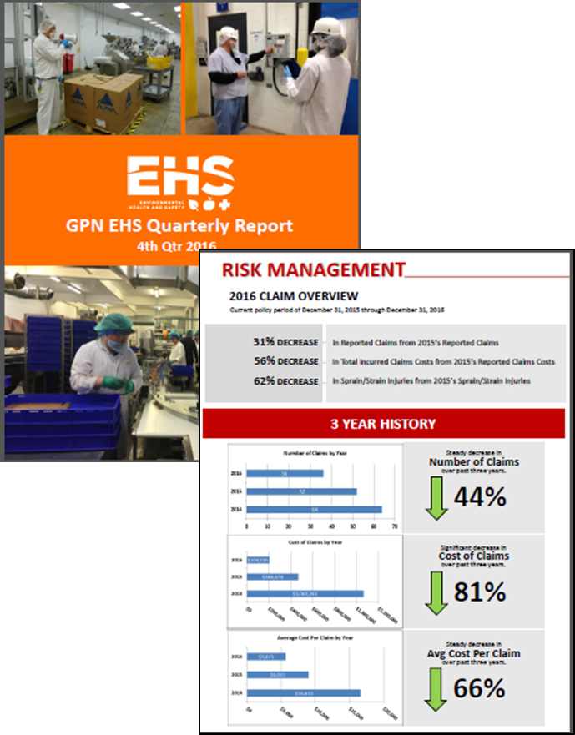
Results
EHS Management Software integral part in driving measurable improvements:
Significant decrease in cost of claims by 81%
2014 claims were $1M - down to $200K in 2016
Steady decrease in OSHA rates
Since adoption in 2013, OSHA rates reduced each year.
2016 decreased 23% from 2015
Change in Safety Culture through all facilities
System brings visibility and accountability – COMMUNICATION!
Ease of reporting – timely results on tracking and communicating KPIs
Quicker adjustment of processes or training based upon trends
More immediate corrective actions yield more efficient change

Slide 12
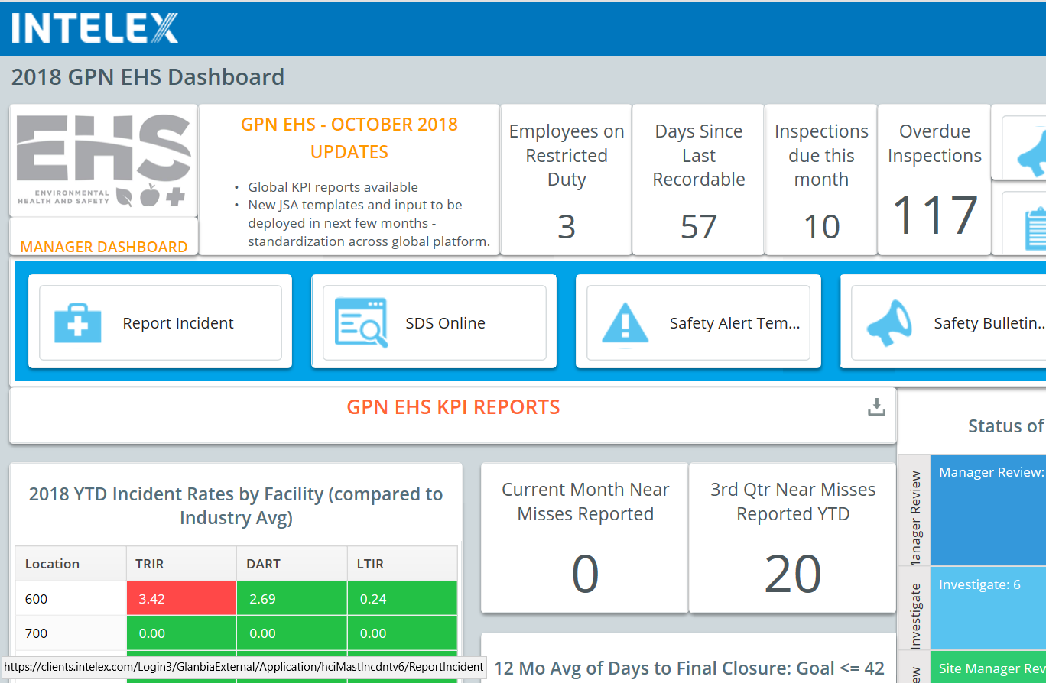
Accountability & Communication
Data without analysis and accountability is useless.

Slide 13
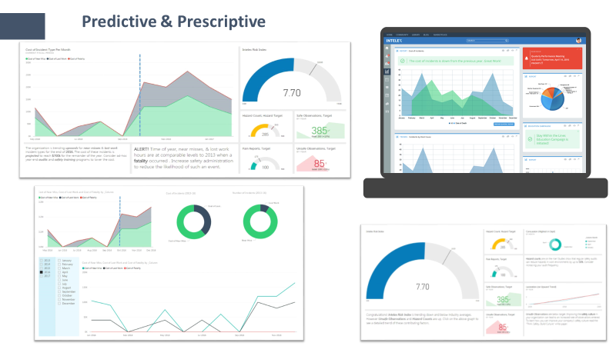
Visibility drives accountability. Must be easy to achieve….

Slide 14
Industry common problems
From: LNS Research, “Elevate the Value of EHS Management”, Bussey, P, 2017

Slide 15
EHS Leadership challenges are….
From: LNS Research, “Elevate the Value of EHS Management”, Bussey, P, 2017

Slide 16
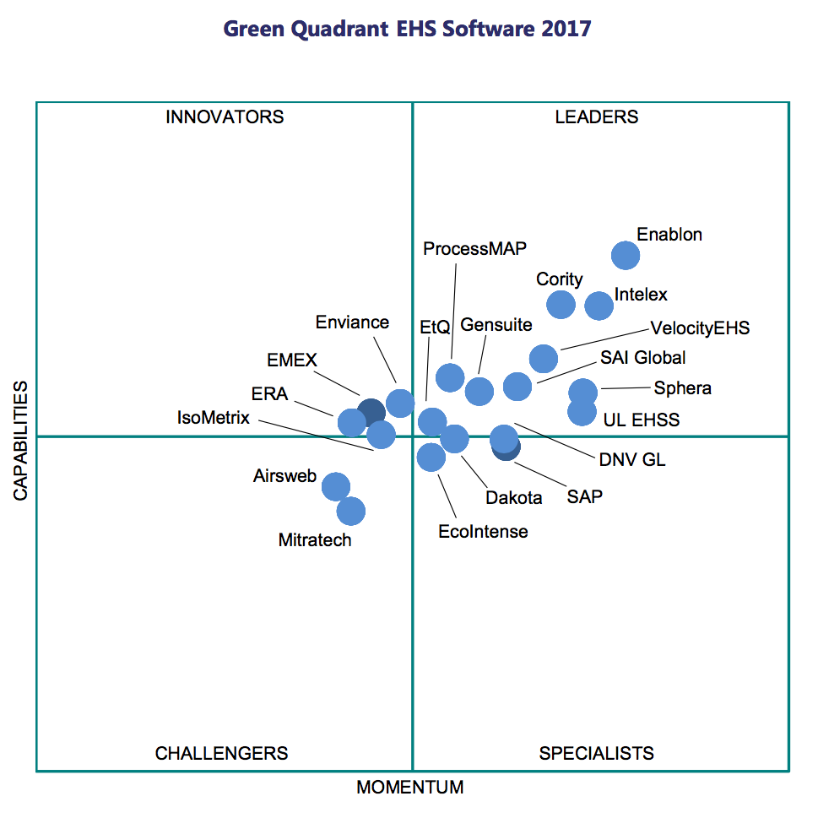
EHS Management Solution Options
Outline your goals first
Outline your challenges
Designate the “Driver” of initiative
Evaluate at least three software solutions
Consider flexibility of configuration
Verdantix Report, June 2017

Slide 17
More than software
CHANGE CAN HAPPEN
Start with priorities first – to gain management approval, develop financial KPIs tied to investment of EHS Management Software.
Communicate, communicate, communicate
Continuouly improvement – revisit results annually and revise KPIs
Change can only come with a combination of tools, analysis, accountability and communication

Slide 18
Thank You
Tresa Adair
501.663.8800
Tresa.adair@harborenv.com
www.harborenv.com

